Slide 1


blockchain-driven police complaint system with access control technique
EAST WEST COLLEGE OF ENGINEERING
BACHELOR OF ENGINEERING
IN
COMPUTER SCIENCE AND ENGINEERING
PROJECT WORK REVIEW (21CSP76)
Project Members Guided By
Anusha b s (1EE21CS004) Prof. Gnanamani. H
Harshitha S (1EE21CS019)
Priyanka H (1EE21CS039)
Ramya B (1EE21CS040)

Slide 2
contents
ABSTRACT
INTRODUCTION
PROBLEM STATEMENT
LITERATURE SURVEY
OBJECTIVES
SYSTEM REQUIREMENTS
SYSTEM ARCHITECTURE
TEST CASES
RESULTS AND CONCLUSION
FUTURE WORK AND REFERENCES

Slide 3
ABSTRACT
The increase in criminal activities and unreported incidents in India highlights the limitations of traditional FIR systems and the centralized Crime and Criminal Tracking Network and System (CCTNS).
To address these challenges, we propose a blockchain-driven police complaint system with access control that ensures secure, transparent, and efficient handling of complaints.
The system encrypts FIRs, stores them securely on a blockchain network, and uses a public cloud to enhance transparency while protecting data privacy.
Authorized access for police officers ensures accountability and promotes trust in law enforcement. This solution aims to create a more responsive, reliable system

Slide 4
INTRODUCTION
In India, offenses are classified into cognizable and non-cognizable types. Cognizable offenses include serious crimes like murder or theft, allowing police to arrest suspects and investigate without court approval. Non-cognizable offenses, such as cheating, require court permission to investigate.
Despite legal provisions, issues like corruption and refusal to register complaints hinder justice. A survey revealed that 24% of people couldn’t register complaints, with 9% facing demands for bribes, and 30% not receiving FIR copies.
To address these challenges, we propose an online blockchain-driven police complaint system with access control, ensuring transparency and decentralized handling of FIRs and complaints.

Slide 5
Problem statement
The current police complaint management systems lack transparency, security, and efficiency, leading to issues like data tampering, delays, and erosion of public trust, which can be addressed using blockchain technology.

Slide 6
Literature survey
SR .NO | PAPER TITLE | AUTHOR NAME | SUMMARY
1. | CRIME RECORDS MANAGEMENT USING BLOCK CHAIN | M.M RAKIBUL HASAN GAZI MD.SHAKIL SADIA HOSSAIN MD SHEPON (2017) | METHODOLOGY BLOCKCHAIN TECHNOLOGY USER AUTHENTICATION MODULE LIMITATION SCALABILITY ISSUES
2. | ONLINE FIR REGISTRATION AND SOS SYSTEM | ANINDITA KHADE SANKET YERIGERI KAUSTUBH SONDE SHIVAGANESH PILLAI (2018) | METHODOLOGY ROBUST AUTHENTICATION LIMITATION INSECURE FIR REGISTRATION

Slide 7
Literature survey
SR .NO | PAPER TITLE | AUTHOR NAME | SUMMARY
3. | SMART COMPLAINT MANAGEMENT SYSTEM | SIRIPEN PONGPAICHET PATTAMAPORN PANIDA LIAWSOMBOO NARUT PHONGOEN (2021) | METHODOLOGY WEB APPLICATION CLASSIFICATION LIMITATION USER AUTHENTICATION
4. | ONLINE CRIME REPORTING SYSTEM | ARCHANA M DURGA S SAVEETHA K (2023) | METHODOLOGY USER FRIENDLY LONG PERIOD STORAGE LIMITATION DATA MANIPULATION USER AUTHENTICATION

Slide 8
OBJECTIVE
To develop a blockchain-based system for lodging and managing police complaints, ensuring tamper-proof storage of FIRs and promoting transparency in the complaint handling process, thus improving the credibility of law enforcement agencies.
To incorporate an effective access control mechanism that ensures only authorized police officers have access to sensitive complaint data, thereby safeguarding the privacy of citizens and ensuring secure handling of information.

Slide 9
System requirements
Hardware Requirements:
System : i3 core processor or above
Hard Disk : 500 GB
RAM : 8 GB
Any desktop / Laptop system with above configuration or higher level
Software requirements :
Operating system : Windows OS
Coding Language : Java
Web Technology : Servlet, JSP
Web Server : TomCAT
IDE : Eclips Indigo
Database : My-SQL
GUI for DB : SQLyog
JDBC Connection : Type 4 Driver

Slide 10
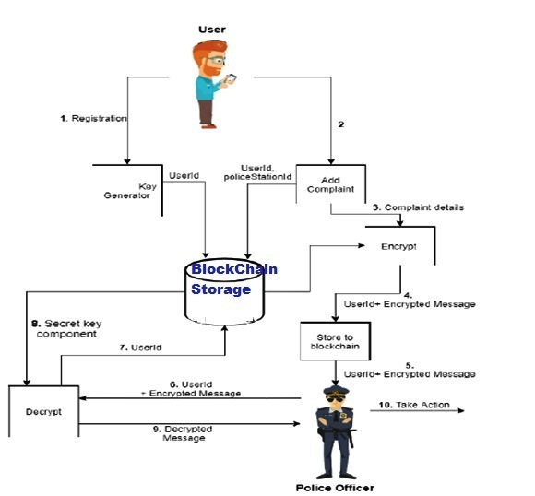
System architecture

Slide 11
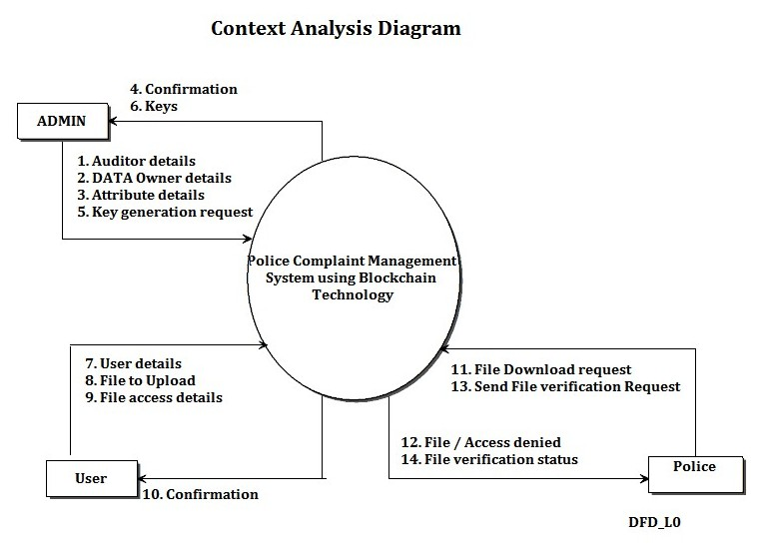
Context analysis

Slide 12

methodology
BLOCK CHAIN
Blockchain is a decentralized digital ledger that records transactions across multiple nodes, ensuring transparency, security, and immutability.
Each block in the chain stores transactions and is cryptographically linked to the previous one, making it nearly impossible to alter or remove data.

Slide 13
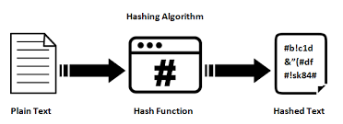
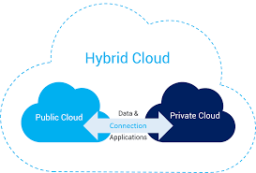
HASHING
1.Data Compilation 2.Hashing
3.Hash Linking 4.Verification
5.Block Addition
HYBRID CLOUD
integrates on-premise private clouds with public clouds,
Flexibility to scale up or down based on workload.
Cost and time savings
In CCT (Crime and Criminal Tracking), fault tolerance ensures continuous operations during component failures.

Slide 14
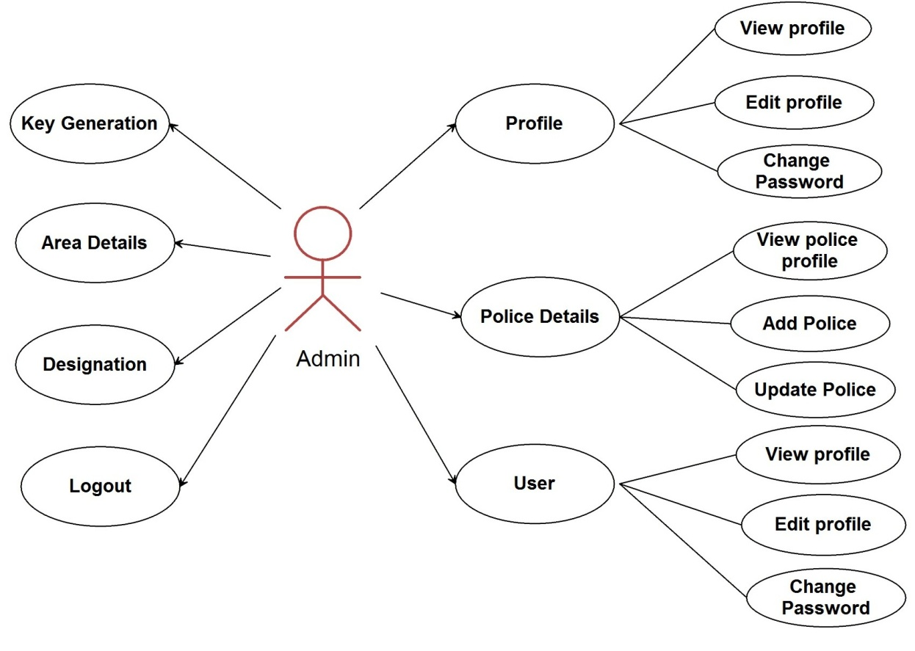
implementation
USE CASE DIAGRAM ADMIN

Slide 15
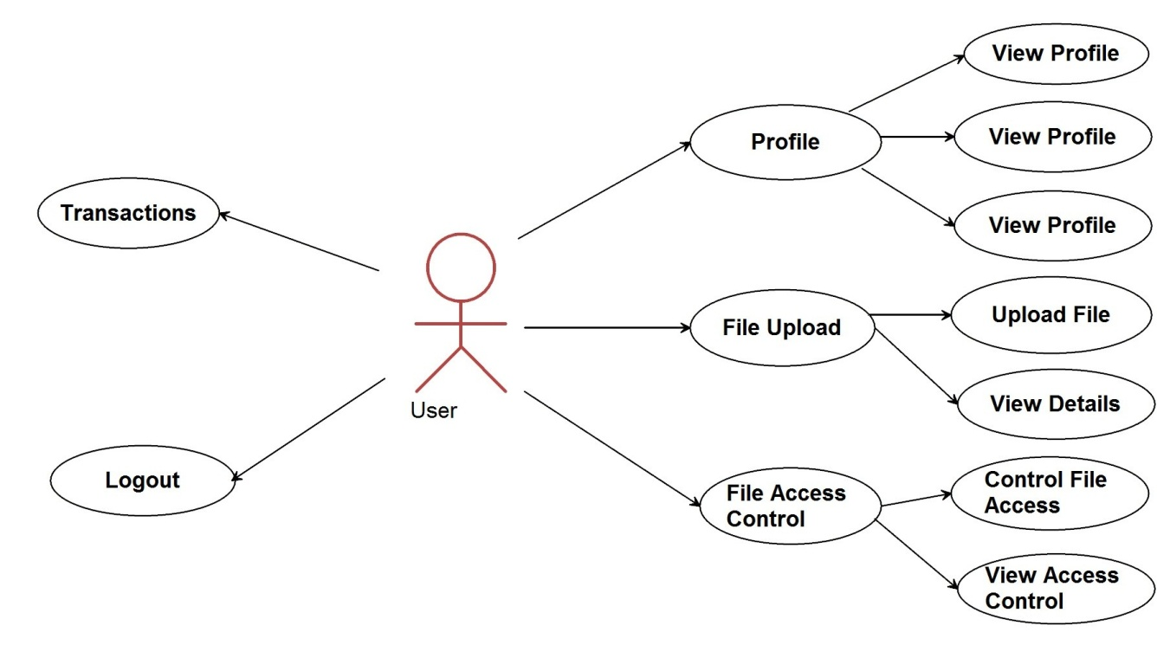
implementation
USE CASE DIAGRAM USER

Slide 16
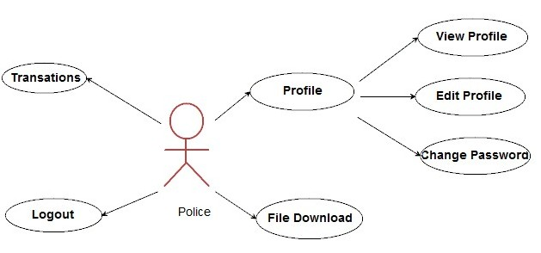
implementation
USE CASE DIAGRAM POLICE

Slide 17
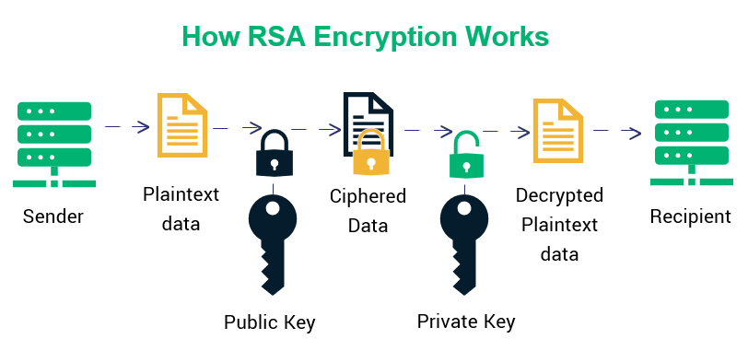
rsa algorithm
Public key: For encryption ,{e,n}
Private key: For decryption ,{d,n}
PROCESS:
Key Generation:
Select two large primes ,p and q ,compute n=p*q
Calculate ϕ(n)=(p−1)×(q−1)
Choose a public exponent e such that 1<e< ϕ(n) and GCD(ϕ(n) ,e)=1
derive the private key d, ensuring edmod ϕ(n)=1
Encryption: The sender encrypts a message m as c= m^e mod(n)
Decryption: The recipient decrypts ciphertext c as m=c^d mod(n)

Slide 18
testing
Table 1: Testing Types Overview
Testing Type | Description
White Box Testing | Tests internal logic, code structures, and paths.
Black Box Testing | Validates functionality without looking at internal code.
Grey Box Testing | Combines white and black box testing to ensure comprehensive coverage.
Table 2: Testing Levels in the Project
Level | Objective
Unit Testing | Verify individual components work as intended.
Integration Testing | Ensure modules interact and work together correctly.
System testing | Evaluate end-to-end functionality in a real-world scenario.
Functional testing | Validate the application against defined requirements.
Alpha Testing | Conduct pre-release testing in a controlled developer environment.
Beta Testing | Perform testing in real-world conditions to identify user-specific issues.

Slide 19
testing
Table 3: Sample Unit Test Cases
Test Case ID | Test Name | Input | Expected Output | Actual Output | Status
UNTC-1 | Login as Admin | Correct username & password | Login successful | Login successful | Pass
UNTC-2 | Login as User | Incorrect username/password | Login failed | Login failed | Pass
Table 4: System Testing Scenarios
Test Case ID | Scenario | OS/Environment | Expected Output | Actual Output | Status
STC-1 | Performance on Windows 10 | Windows 10 | Smooth performance | Smooth performance | Pass
STC-2 | Browser Compatibility Testing | Chrome, Firefox, Edge | Consistent functionality | Consistent functionality | Pass

Slide 20
testing
Table 5: Defect Tracking
Defect ID | Description | Reported By | Priority | Status
DEF-101 | Incorrect password reset logic | QA Engineer | High | Resolved
DEF-102 | UI alignment issue on the login page | QA Engineer | Medium | In Progress

Slide 21
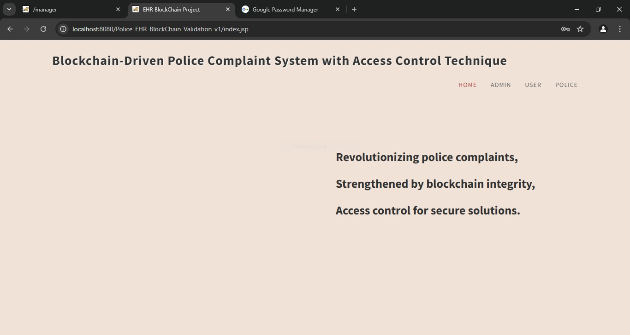
results

Slide 22
results

Slide 23
results

Slide 24
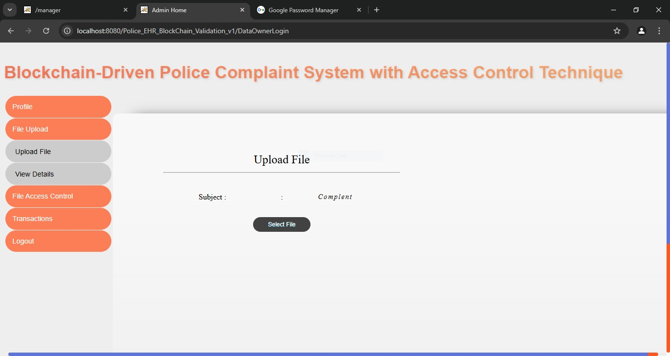
results

Slide 25
conclusion
The blockchain-based police complaint management system overcomes the challenges of traditional FIR lodging and centralized systems like CCTNS by ensuring:
Security: Immutable and tamper-proof records.
Transparency: Trustworthy processes for citizens and law enforcement.
Efficiency: Faster handling of complaints with encrypted public cloud networks.
This innovative solution enhances accountability, promotes consistency, and fosters a safer, more credible environment for citizens and law enforcement agencies.

Slide 26
Future work
AI Integration:
Use advanced AI for automated complaint analysis and prioritization.
Enhanced Scalability:
Implement robust blockchain frameworks for handling higher complaint volumes.
Cross-Jurisdictional Collaboration:
Enable seamless crime tracking and management across regions.
User Accessibility:
Incorporate features like anonymous reporting, multilingual support, and offline functionality.
Predictive Analytics:
Utilize predictive tools to aid in crime prevention.
Database Linkage:
Integrate with national and smart city databases to strengthen investigations.

Slide 27
references
Shivaganesh Pillai, "Online FIR Registration and SOS System," International Journal of Engineering and Computer Science, vol. 5, no. 4, Dec. 2017.
Omoregbe, Nicholas; Misra, Sanjay; Maskeliunas, Rytis; Damasevicius, Robertas; Adesola, Falade Adewole, "Crime Reporting Innovations," 2019.
Kormpho, P., Liawsomboon, N., Phongoen, N., Pongpaichet, S., "Smart Complaint Management System," Seventh ICT International Student Project Conference (ICT-ISPC), Nakhonpathom, 2018.
Dini, A. T., Abete, E. Gabriel, Colombo, M., Guevara, J., Hoffmann, B. S. Menchón, Abeledo, M. Claudia, "Implementing Blockchain for Criminal Records," 2018.
Godlin Jesil, S. P., Rajat Basant, Pratishvir, "Crime Reporting System Using Android Application," International Journal of Pure and Applied Mathematics, vol. 119, no. 7, 2018.
Tabassum, K., Shaiba, H., Shamrani, S., Otaibi, S., "e-Cops: An Online Crime Reporting and Management System for Riyadh City," 1st International Conference on Computer Applications and Information Security (ICCAIS), Riyadh, 2018.

Slide 28

Thank you…

